Slide 1

Arithmetic and
Edited Pictures

Slide 2
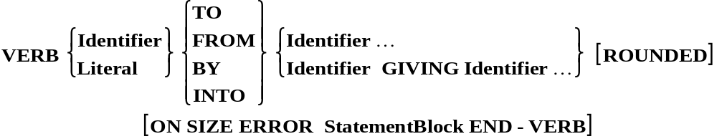
Arithmetic Verb Template
Most COBOL arithmetic verbs conform to the template above. For example;
ADD Takings TO CashTotal.
ADD Males TO Females GIVING TotalStudents.
SUBTRACT Tax FROM GrossPay.
SUBTRACT Tax FROM GrossPay GIVING NetPay.
DIVIDE Total BY Members GIVING MemberAverage.
DIVIDE Members INTO Total GIVING MemberAverage.
MULTIPLY 10 BY Magnitude.
MULTIPLY Members BY Subs GIVING TotalSubs.
The exceptions are the COMPUTE and the DIVIDE with REMAINDER.

Slide 3
The ROUNDED option
Receiving Field Actual Result Truncated Result Rounded Result
PIC 9(3)V9. 123.25
PIC 9(3). 123.25
123.2 123.3
123 123
The ROUNDED option takes effect when, after decimal point alignment, the result calculated must be truncated on the right hand side.
The option adds 1 to the receiving item when the leftmost truncated digit has an absolute value of 5 or greater.

Slide 4
The ON SIZE ERROR option
Receiving Field Actual Result SIZE ERROR
PIC 9(3)V9. 245.96
PIC 9(3)V9. 1245.9
PIC 9(3). 124
PIC 9(3). 1246
PIC 9(3)V9 Not Rounded 124.45
PIC 9(3)V9 Rounded 124.45
PIC 9(3)V9 Rounded 3124.45
Yes
Yes
No
Yes
Yes
No
Yes
A size error condition exists when, after decimal point alignment, the result is truncated on either the left or the right hand side.
If an arithmetic statement has a rounded phrase then a size error only occurs if there is truncation on the left hand side (most significant digits).

Slide 5
ADD Examples
ADD Cash TO Total.
Before 3 1000
After
ADD Cash, 20 TO Total, Wage.
Before 3 1000 100
After
ADD Cash, Total GIVING Result.
Before 3 1000 0015
After
ADD Males TO Females GIVING TotalStudents.
Before 1500 0625 1234
After
3 1003
3 1023 123
3 1000 1003
1500 0625 2125

Slide 6
SUBTRACT Examples
SUBTRACT Tax FROM GrossPay, Total.
Before 120 4000 9120
After
SUBTRACT Tax, 80 FROM Total.
Before 100 480
After
SUBTRACT Tax FROM GrossPay GIVING NetPay.
Before 750 1000 0012
After
120 3880 9000
100 300
750 1000 0250

Slide 7
MULTIPLY and DIVIDE Examples
MULTIPLY Subs BY Members GIVING TotalSubs
ON SIZE ERROR DISPLAY "TotalSubs too small"
END-MULTIPLY.
Subs Members TotalSubs
Before 15.50 100 0123.45
After
MULTIPLY 10 BY Magnitude, Size.
Before 355 125
After
DIVIDE Total BY Members GIVING Average ROUNDED.
Before 9234.55 100 1234.56
After
15.50 100 1550.00
3550 1250
9234.55 100 92.35

Slide 8
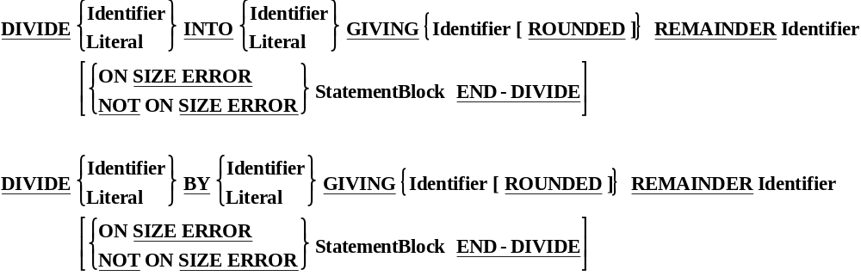
The Divide Exception
DIVIDE 201 BY 10 GIVING Quotient REMAINDER Remain.
Before 209 424
After
020 001

Slide 9
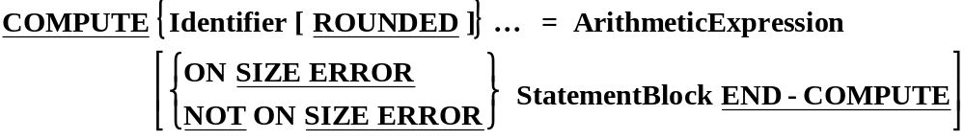
The COMPUTE
Precedence Rules.
1. ** = POWER N^{N}
2. * = MULTIPLY x
/ = DIVIDE ÷
3. + = ADD +
- = SUBTRACT -
Compute IrishPrice = SterlingPrice / Rate * 100.
Before 1000.50 156.25 87
After
179.59 156.25 87

Slide 10
Edited Pictures.
Edited Pictures are PICTURE clauses which format data intended for output to screen or printer.
To enable the data items to be formatted in a particular style COBOL provides additional picture symbols supplementing the basic 9, X, A, V and S symbols.
The additional symbols are referred to as “Edit Symbols” and PICTURE clauses which include edit symbols are called “Edited Pictures”.
The term edit is used because the edit symbols have the effect of changing, or editing, the data inserted into the edited item.
Edited items can not be used as operands in a computation but they may be used as the result or destination of a computation (i.e. to the right of the word GIVING).

Slide 11
Editing Types
COBOL provides two basic types of editing
Œ Insertion Editing - which modifies a value by including additional items.
 Suppression and Replacement Editing -
which suppresses and replaces leading zeros.
Each type has sub-categories
Insertion editing
Simple Insertion
Special Insertion
Fixed Insertion
Floating Insertion
● Suppression and Replacement
Zero suppression and replacement with spaces
Zero suppression and replacement with asterisks

Slide 12
Editing Symbols
Edit Symbol Editing Type
, B 0 / Simple Insertion
. Special Insertion
+ - CR DB $ Fixed Insertion
+ - S Floating Insertion
Z * Suppression and Replacement

Slide 13
Simple Insertion.
Sending Receiving
Picture Data Picture Result
PIC 999999 123456 PIC 999,999
PIC 9(6) 000078 PIC 9(3),9(3)
PIC 9(6) 000078 PIC ZZZ,ZZZ
PIC 9(6) 000178 PIC ***,***
PIC 9(6) 002178 PIC ***,***
PIC 9(6) 120183 PIC 99B99B99
PIC 9(6) 120183 PIC 99/99/99
PIC 9(6) 001245 PIC 990099
123,456
000,078
78
****178
**2,178
120183
12/01/83
120045

Slide 14
Special Insertion.
Sending Receiving
Picture Data Picture Result
PIC 999V99 12345 PIC 999.99
PIC 999V99 02345 PIC 999.9
PIC 999V99 51234 PIC 99.99
PIC 999 456 PIC 999.99
123.45
023.4
12.34
456.00

Slide 15
Fixed Insertion - Plus and Minus.
Sending Receiving
Picture Data Picture Result
PIC S999 -123 PIC -999
PIC S999 -123 PIC 999-
PIC S999 +123 PIC -999
PIC S9(5) +12345 PIC +9(5)
PIC S9(3) -123 PIC +9(3)
PIC S9(3) -123 PIC 999+
-123
123-
123
+12345
-123
123-

Slide 16
Fixed Insertion - Credit, Debit, $
Sending Receiving
Picture Data Picture Result
PIC S9(4) +1234 PIC 9(4)CR
PIC S9(4) -1234 PIC 9(4)CR
PIC S9(4) +1234 PIC 9(4)DB
PIC S9(4) -1234 PIC 9(4)DB
PIC 9(4) 1234 PIC $99999
PIC 9(4) 0000 PIC $ZZZZZ
1234
1234CR
1223
1234DB
$01234
$

Slide 17
Floating Insertion.
Sending Receiving
Picture Data Picture Result
PIC 9(4) 0000 PIC $$,$$9.99
PIC 9(4) 0080 PIC $$,$$9.00
PIC 9(4) 0128 PIC $$,$$9.99
PIC 9(5) 57397 PIC $$,$$9
PIC S9(4) - 0005 PIC ++++9
PIC S9(4) +0080 PIC ++++9
PIC S9(4) - 0080 PIC - - - - 9
PIC S9(5) +71234 PIC - - - - 9
$0.00
$80.00
$128.00
$7,397
-5
+80
-80
ž1234

Slide 18
Suppression and Replacement
Sending Receiving
Picture Data Picture Result
PIC 9(5) 12345 PIC ZZ,999
PIC 9(5) 01234 PIC ZZ,999
PIC 9(5) 00123 PIC ZZ,999
PIC 9(5) 00012 PIC ZZ,999
PIC 9(5) 05678 PIC **,**9
PIC 9(5) 00567 PIC **,**9
PIC 9(5) 00000 PIC **,***
12,345
1,234
123
012
*5,678
***567
******

Slide 19
Conditions.

Slide 20
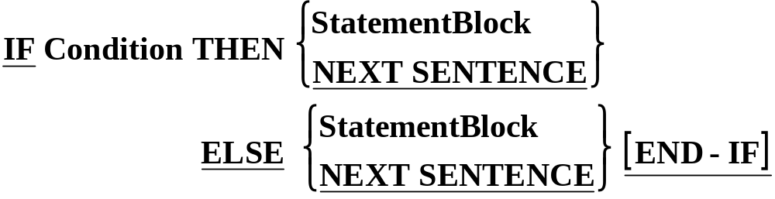
IF Syntax.
CONDITION TYPES
Simple Conditions
  Relation Conditions
  Class Conditions
  Sign Conditions
Complex Conditions
Condition Names

Slide 21
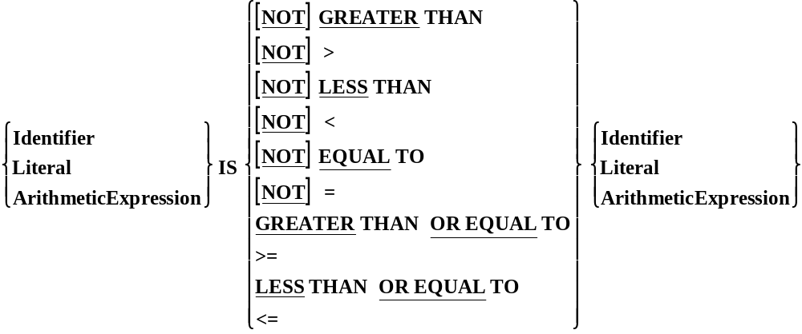
Relation Conditions
Notes:
NOTE :
Notice that the Modula-2 type not equals <> is not permitted.

Slide 22
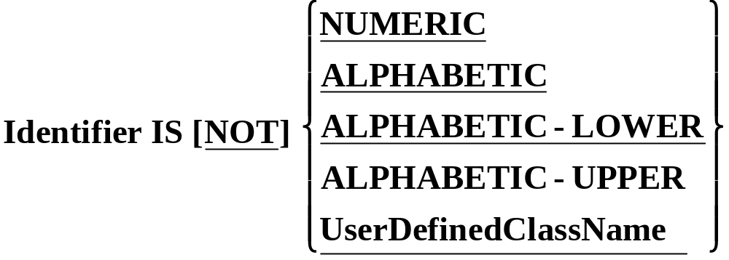
Class Conditions.
Although COBOL data items are not ‘typed’ they do fall into some broad categories, or classes, such a numeric or alphanumeric, etc.
A Class Condition determines whether the value of data item is a member of one these classes.

Slide 23
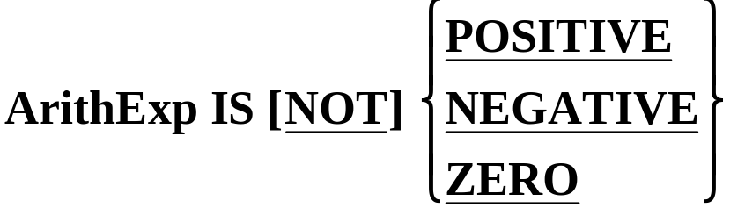
Sign Conditions
The sign condition determines whether or not the value of an arithmetic expression is less than, greater than or equal to zero.
Sign conditions are just another way of writing some of the Relational conditions.

Slide 24
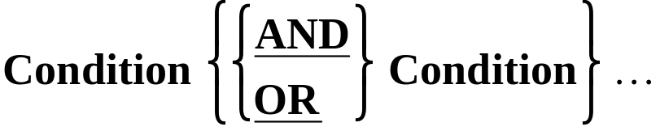
Complex conditions.
Like all other programming languages COBOL allows simple conditions to be combined using OR and AND to form composite conditions.
Like other conditions, a complex condition evaluates to true or false.
A complex condition is an expression which is evaluated from left to right unless the order of evaluation is changed by the precedence rules or bracketing.

Slide 25
Implied Subjects.
IF TotalAmt > 10000 AND TotalAmt < 50000 THEN
  IF Grade = “A” OR Grade = “B+” OR GRADE = “B” THEN
  IF VarA > VarB AND VarA > VarC AND VarA > VarD
  DISPLAY “VarA is the Greatest”
  END-IF
In these situations COBOL provides an abbreviation mechanism called implied subjects.
The statements above may be re-written using implied subjects as;
  IF TotalAmt > 10000 AND < 50000 THEN
  IF Grade=“A” OR “B+” OR “B” THEN
  IF VarA > VarB AND VarC AND VarD
  DISPLAY “VarA is the Greatest”
  END-IF

